Slide 1
Flow Control Instructions
Course Code: CSC 2106
Course Title: Computer Organization and Architecture
Dept. of Computer Science
Faculty of Science and Technology
Lecturer No: | 6.2 | Week No: | 8 | Semester: | Summer 23-24
Lecturer: | Md. Faruk Abdullah Al Sohan; faruk.sohan@aiub.edu

Slide 2
Lecture Outline
  Decision making and repeating statement
  Jump and loop instructions
  Algorithm conversion to assembly language
  High-Level Language Structures

Slide 3
Branches with Compound Conditions
Sometimes the branching condition in an IF or CASE takes the form
            condition_1' AND condition_2’
            or
            condition_1 OR condition_2
Where condition 1 and condition:2 are either true or false. We will refer to the
First of these as an AND condition and to the second as an OR condition.

Slide 4

Example : AND
An AND condition is true if and only if Condition_1 and Condition_2 are both true. Likewise, if either condition is false, then the whole thing is false.
Read a character, and if it's an uppercase letter, display it.
Read a character (into AL)
IF (character >= 'A') and (character <= 'Z')
THEN
display character
END IF

Slide 5
Converting to Assembly
;read a character
MOV AH,1
INT 21H
; if ('A' <= char> and (chai: <= 'Z')
CMP AL, ‘A’ ;char >’A’
JL END_lF ;no exit
CMP AL, 'Z'
JG END_lF ;no exit
MOV DL, AL.
MOV AH, 2
INT 21H
END_IF:

Slide 6
What the code does | Simple meaning
MOV AH,1 | Tell the computer: “I want to read a key from the keyboard.”
INT 21H | The computer waits for you to press a key. It stores the pressed key in AL.
CMP AL, 'A' | Check if the key is before the letter A.
JL END_IF | If it is before A → jump to END_IF (meaning: “the key is NOT an uppercase letter”).
CMP AL, 'Z' | Check if the key is after the letter Z.
JG END_IF | If it is after Z → jump to END_IF (not uppercase).
(If the program reaches here, the key is from A to Z) | Meaning: “Yes, the key is an uppercase letter.”
MOV DL, AL | Put the uppercase letter into DL so it can be printed.
MOV AH, 2 | Tell the computer: “I want to print a character.”
INT 21H | Print the letter that is inside DL.
END_IF: | A marker where the program goes if the character was NOT uppercase.

Slide 7
OR Conditions
Condition_1 OR condition_2 is true if at least one of the conditions is true; it is only false when both conditions are false.
Read a character. If it's "y" or "Y", display it; otherwise, terminate the program.
Read a character (into AL)
IF (character = ‘y‘) OR (character = 'Y‘)
THEN
display it
ELSE
terminate the program
END IF

Slide 8
Assembly Conversion
MOV AH,1 INT 21H CMP AL,’y’ ;AL==‘y’ JE THEN CMP AL, 'Y';char ~ 'Y'? JE THEN ;yes, go to display it JMP ELSE_ ;no - Terminate | THEN: MOV AH,2 ;prepare to display MOV DL,AL ;get char INT 21H ;display it JMP END IF ;and exit – ELSE_: MOV AH, 4CH INT 21H ;DOS exit END_IF:

Slide 9
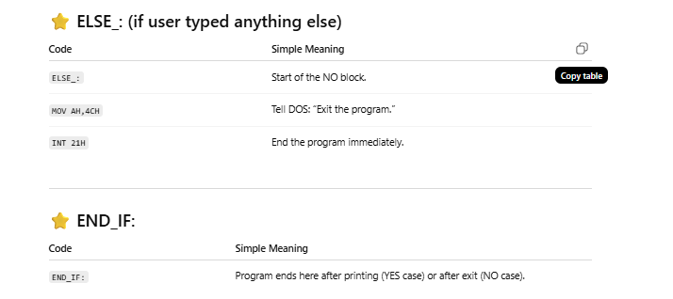
Code | Simple Meaning
MOV AH,1 | Tell DOS: “I want to read a key from the keyboard.”
INT 21H | Wait for a key press → the key goes into AL.
CMP AL,'y' | Check if the key you typed is ‘y’.
JE THEN | If AL == ‘y’, jump to THEN (meaning: “yes, it is ‘y’”).
CMP AL,'Y' | Check if the key is ‘Y’ (uppercase Y).
JE THEN | If AL == ‘Y’, jump to THEN (meaning: “yes, it is ‘Y’”).
JMP ELSE_ | If the key is NOT ‘y’ or ‘Y’, go to ELSE_ (the NO branch).
Code | Simple Meaning
THEN: | Start of the YES block.
MOV AH,2 | Tell DOS: “I want to print a character.”
MOV DL,AL | Put the typed character (AL) into DL → this is the character to print.
INT 21H | Print the character on the screen.
JMP END_IF | After printing, jump to END_IF to finish.

Slide 10
Looping Structure
A loop Is a sequence of instructions that is repeated.
The number of times to repeat may be known in advance, or
It may depend on conditions
  1. FOR LOOP
  2. WHILE LOOP
  3. REPEAT LOOP

Slide 11
FOR LOOP
FOR LOOP is a loop structure in which the loop statements are repeated a known number of times (a count-controlled loop). In pseudo code,
FOR loop_count times DO
Statements
END_FOR
The LOOP instruction can be used to implement a FOR loop. i.e.
LOOP destination_label
The counter for the loop is the register CX which is initialized to loop_count.
Execution of the LOOP Instruction causes CX to be decremented automatically,

Slide 12
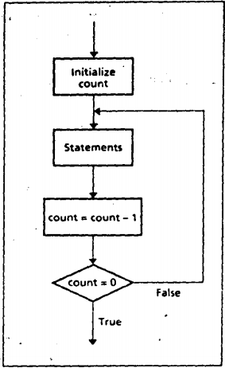
FOR LOOP
The control is transferred to destination_label until CX becomes 0.
A FOR LOOP can be implemented using the LOOP instruction:
TOP:
;initialize CX to loop_count
;body of the loop
        LOOP TOP

Slide 13
Example:
Write a count-controlled loop to display a row of 80 stars:
FOR 80 times DO
display ‘*’
END_FOR
            MOV CX,80
            TOP:
            MOV AH,2
            MOV DL, ‘*’
            INT 21H
            LOOP TOP

Slide 14
JCXZ and The LOOP
FOR LOOP executes at least once.
  if CX contains 0 when the loop is entered, the LOOP instruction causes CX to be decremented to FFFFh
  The loop is then executed FFFFh=65535 times more!
To Prevent this, the instruction JCXZ (jump if CX is zero) may be used before the loop. Its syntax
                JCXZ destination_label

Slide 15
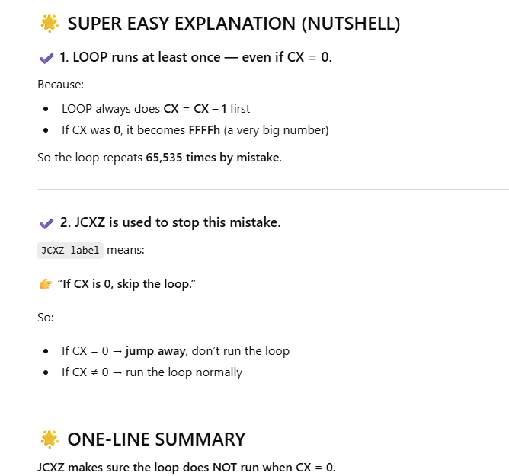

Slide 16
Use of JCXZ
If CX contains 0, control transferred to the destination label. So a loop implemented as follows is bypassed if CX is 0:
JCXZ SKIP
TOP:
            ;body of the loop
            LOOP TOP
        SKIP:

Slide 17
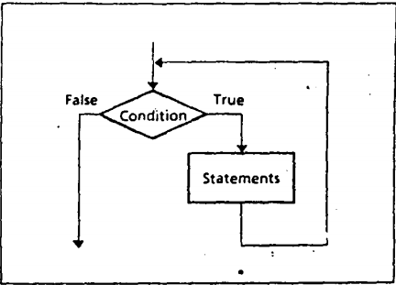
WHILE LOOP
This WHILE LOOP depends on a condition.
WHILE condition DO
            statements
            END_WHILE

Slide 18
WHILE LOOP
The condition is checked at the top of the loop.
  If true, the statements are executed;
  If false, the program goes on to whatever follows.
It is possible the condition will be false initially, in which case the loop body ls not executed at all.
The loop executes as long as the condition is true

Slide 19
Example: WHILE LOOP
MOV DX,0 ; char count
MOV AH,1
INT 21H
WHILE_:
CMP AL,0DH ; CR ?
JE END_WHILE ;yes, exit INC DX ; not CR so inc
    INT 21H ; read next char
    JMP WHILE_ ; loop again
    END_WHILE:
Write some code to count the number of characters in an input line.
Initialize count to 0
Read a character
WHILE character <> carriage_return DO
count =count + 1
read a character
END_WHILE

Slide 20
WHILE LOOP Insights
A WHILE loop checks the terminating condition at the top of the loop,
So, you must make sure that any variables involved in the condition are initialized before the loop is entered.
So you read a character before entering the loop, and read another one at the bottom.
The label WHILE_: .is used because WHILE is a reserved word

Slide 21
Pseudocode (English) | Assembly | Meaning (Very Easy)
Set count = 0 | MOV DX,0 | DX will store how many characters you typed
Read a character | MOV AH,1 INT 21H | Reads 1 key → goes into AL
Start loop | WHILE_: | Beginning of loop
Is character Enter? | CMP AL,0DH | Compare AL with 0DH (ENTER key)
If yes → stop | JE END_WHILE | If AL = ENTER → exit loop
Increase count | INC DX | Add 1 to count (because this was a normal character)
Read next character | INT 21H | Read another key into AL
Repeat loop | JMP WHILE_ | Go check again
End loop | END_WHILE: | Loop finished

Slide 22
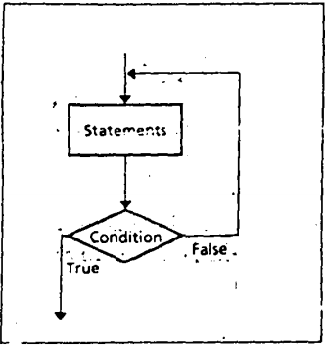
REPEAT LOOP
    REPEAT statements
    UNTIL condition
    In a REPEAT…UNTIL loop, the statements are executed, and then the condition is checked.
    If true, the loop terminates;
    If false, control branches to the top of the loop.

Slide 23
Example: REPEAT LOOP
Write code to read characters until a blank is read.
MOV AH,1
REPEAT:
INT 21H
          CMP AL,' '
          JNE REPEAT
REPEAT
read a character
UNTIL character is a BLANK

Slide 24
Code | Meaning
MOV AH,1 | Select DOS service read a single character
REPEAT: | Label → start of loop
INT 21H | Actually reads a character from the keyboard and stores it in AL
CMP AL, ' ' | Check if the character is a space
JNE REPEAT | If the character is NOT a space → go back and read again

Slide 25
Difference between WHILE and REPEAT
Use of a WHILE loop or a REPEAT loop Is a matter of personal preference.
The advantage of a WHILE is that the loop can be bypassed if the terminating, condition is initially false.
Whereas the statements in a REPEAT must be done at least once.
However, the code for a REPEAT loop Is likely to be a little shorter because there is only a conditional jump at the end,
But a WHILE loop has two jumps: a conditional jump at the top and a JMP at the bottom.

Slide 26
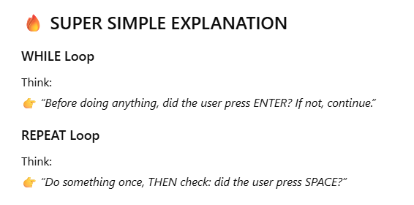

Slide 27
Feature | WHILE Loop | REPEAT–UNTIL Loop
Condition checked | At the beginning | At the end
Runs at least once? | ❌ No (may run 0 times) | ✅ Yes (always runs ≥ 1 time)
Structure | WHILE condition NOT met → run body | Run body → stop when condition is met
Assembly style | Check first, then loop | Loop first, check later
Pseudo-code | WHILE x != 0 do something | REPEAT do somethingUNTIL x == 0
When to use | When you may skip loop entirely | When you must execute at least once
Example meaning | “Do this while condition is true” | “Do this until condition becomes true”

Slide 28
References
Assembly Language Programming and Organization of the IBM PC, Ytha Yu and Charles Marut, McGraw Hill, 1992. (ISBN: 0-07-072692-2).
https://www.slideshare.net/prodipghoshjoy/flow-control-instructions-60602372

Slide 29
Books
Assembly Language Programming and Organization of the IBM PC, Ytha Yu and Charles Marut, McGraw Hill, 1992. (ISBN: 0-07-072692-2).
Essentials of Computer Organization and Architecture, (Third Edition), Linda Null and Julia Lobur
W. Stallings, “Computer Organization and Architecture: Designing for performance”, 67h Edition, Prentice Hall of India, 2003, ISBN 81 – 203 – 2962 – 7
Computer Organization and Architecture by John P. Haynes.

